Slide 1


SWE 321- Lecture 2
Afsana Begum
Department of Software Engineering
Daffodil International University

Slide 2

What is Topology
Categories of Topology
Definition , structure , advantage and disadvantage of all of the following topologies:
Mesh
Bus
Ring
Star
Tree
Hybrid

Slide 3

In computer networking, topology refers to the layout of connected devices.
Think of a topology as a network's virtual shape or structure.

Slide 4

Network topologies are categorized into the following basic types:
Mesh
Bus
Ring
Star
Tree
Hybrid

Slide 5

It is a point-to-point connection to other nodes or devices. Traffic is carried only between two devices or nodes to which it is connected.
Mesh technology comes into two types:
Full Mesh
Partially Mesh

Slide 6
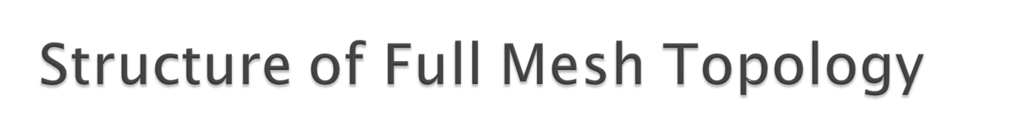
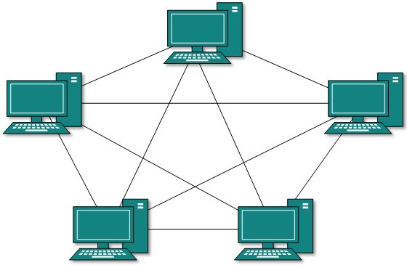
All hosts have a point-to-point connection to every other host in the
network. Thus for every new host n(n-1)/2 connections are required.

Slide 7
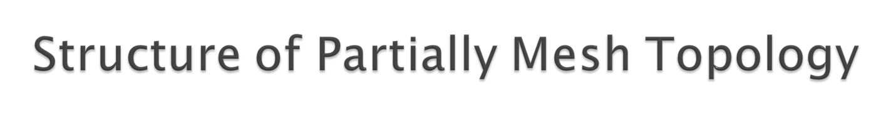
Not all hosts have point-to-point connection to every other host.

Slide 8
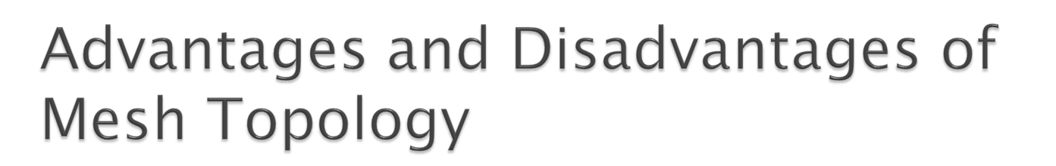
Advantages:
It provides the most reliable network structure among all network topologies.
Even if one of the components fails ,data transfer doesn’t get affected.
Expansion and modification in topology can be done without disrupting other nodes.
Disadvantages:
There are high chances of redundancy in many of the network connections.
Overall cost of this network is way too high as compared to other network topologies.
Set-up and maintenance of this topology is very difficult. Even administration of the network is tough.

Slide 9

Bus networks use a common backbone to connect all devices.
A device wanting to communicate with another device on the network sends a broadcast message onto the wire that all other devices see, but only the intended recipient actually accepts and processes the message.

Slide 10
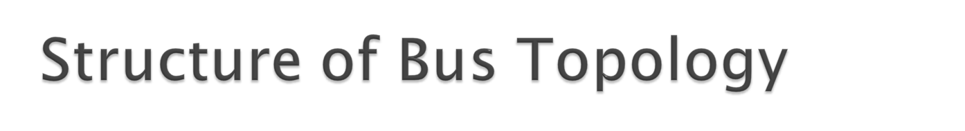
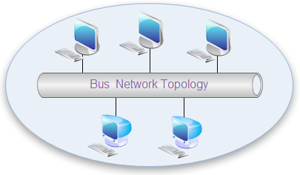

Slide 11
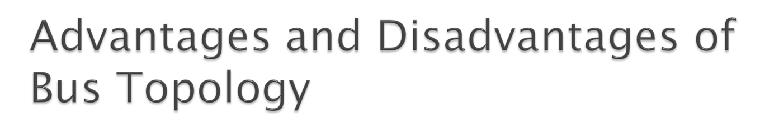
Advantages:
It is easy to extend bus network.
Cable length required for this topology is the least compared to other networks.
Bus topology costs very less.
Disadvantages:
There is a limit on central cable length and number of nodes that can be connected.
If the main cable (i.e. bus ) encounters some problem, whole network breaks down.
It is difficult to detect and troubleshoot fault at individual station.

Slide 12
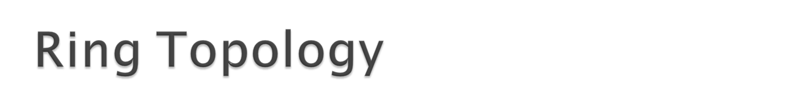
In Ring Topology, all the nodes are connected to each-other in such a way that they make a closed loop. Each workstation is connected to two other components on either side, and it communicates with these two adjacent neighbors. Data travels around the network, in one direction. Sending and receiving of data takes place by the help of TOKEN.

Slide 13
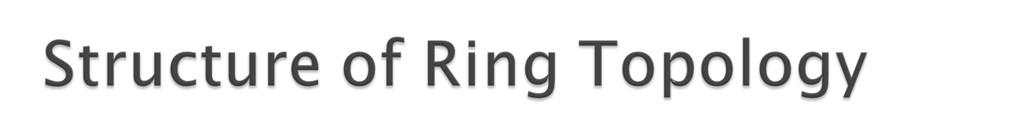
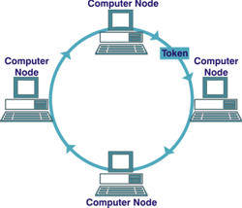

Slide 14
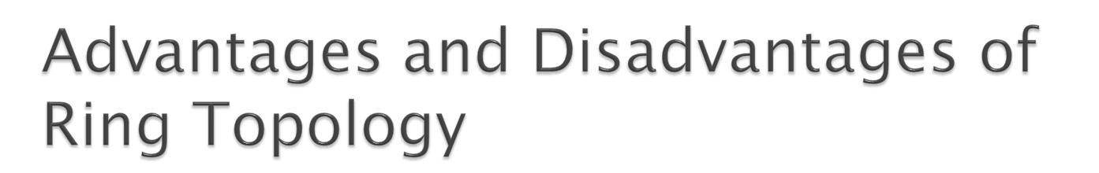
Advantages:
Easy to add or remove nodes
There is no need for network server to control the connectivity between workstations.
Each computer has equal access to resources.
Disadvantages:
If one workstation or port goes down, the entire network gets affected.
Network is highly dependent on the wire which connects different components.
Each packet of data must pass through all the computers between source and destination. This makes it slower

Slide 15

In Star topology, all the components of network are connected to the central device called “hub” which may be a hub, a router or a switch.

Slide 16
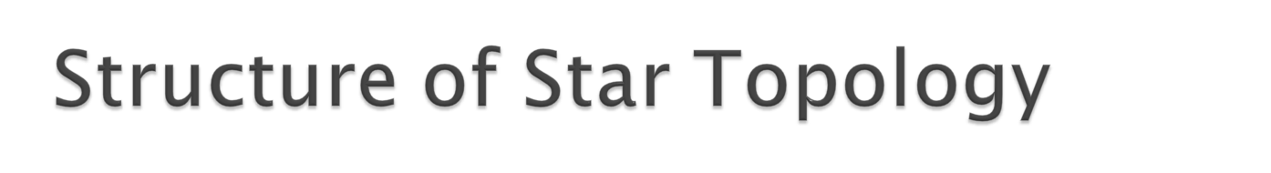
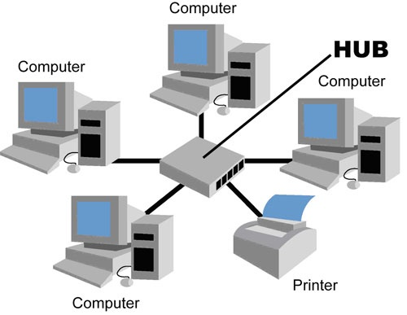

Slide 17
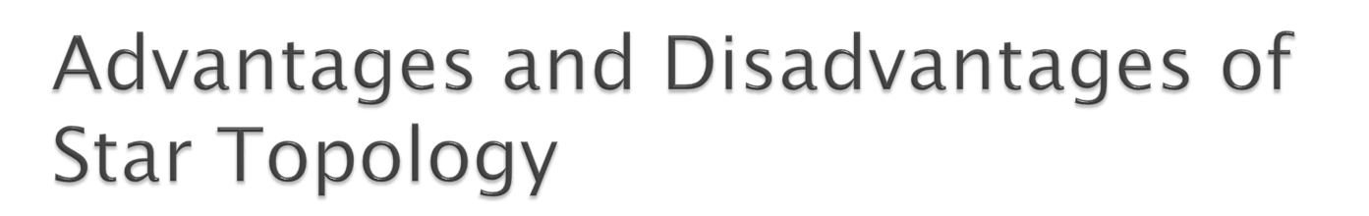
Advantages:
Centralized management. It helps in monitoring the network.
Failure of one node or link doesn’t affect the rest of network.
Easy to connect new nodes or devices.
Disadvantages:
Too much dependency on central device has its own drawbacks.
The use of hub, a router or a switch as central device increases the overall cost of the network.
Performance and as well number of nodes which can be added in such topology is depended on capacity of central device.

Slide 18

It is also called Expanded Star Topology.
Tree Topology integrates the characteristics of Star and Bus Topology.
In Tree Topology, the number of Star networks are connected using Bus.
This main cable seems like a main stem of a tree, and other star networks as the branches.

Slide 19
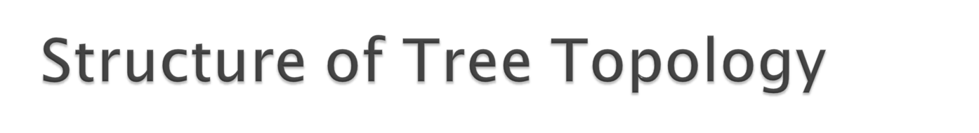
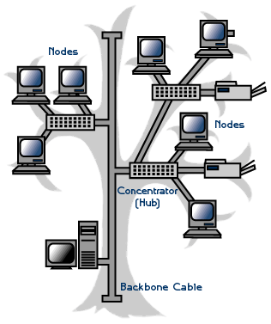

Slide 20
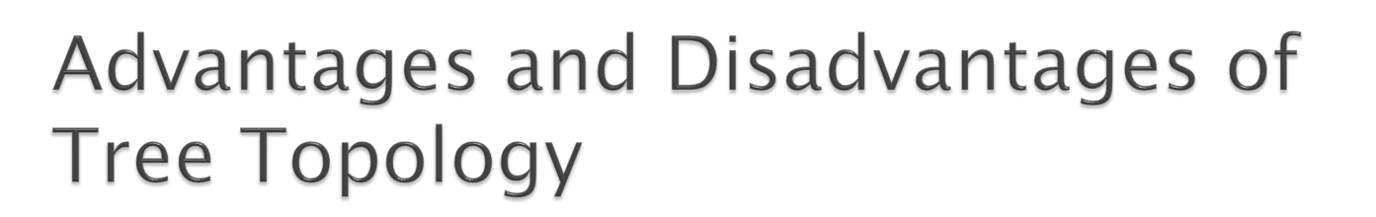
Advantages:
Expansion of Network is possible and easy.
If one segment is damaged, other segments are not affected.
Error detection and correction is easy.
Disadvantages:
Relies heavily on the main bus cable, if it breaks whole network is crippled.
Ability of work of cable of the network depends on the type of cable used.
As more and more nodes and segments are added, the maintenance becomes difficult.

Slide 21
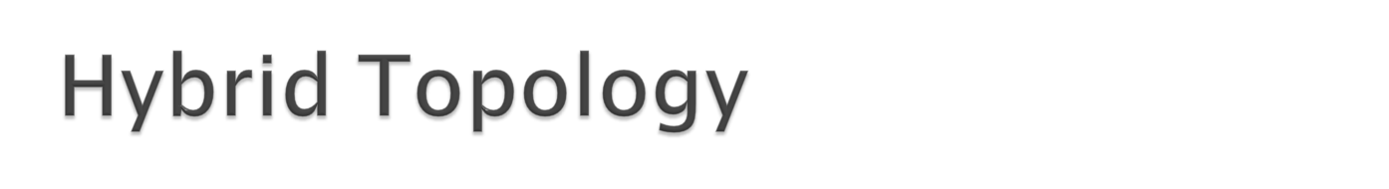
This type of topology we integrate two or more different topologies to form a resultant topology which has good points(as well as weaknesses) of all the constituent basic topologies rather than having characteristics of one specific topology.

Slide 22
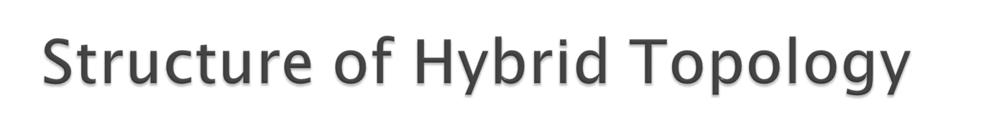
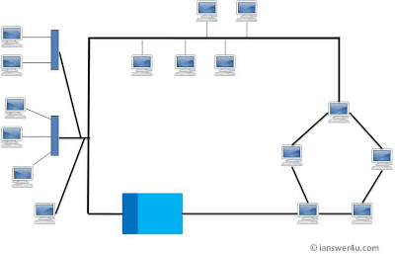

Slide 23
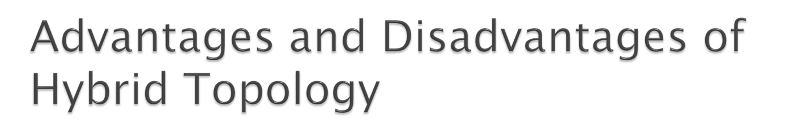
Advantages:
Reliable : Unlike other networks, fault detection and troubleshooting is easy in this type of topology.
Scalable: Its easy to increase the size of network by adding new components, without disturbing existing architecture.
Effective: Hybrid topology is the combination of two or more topologies, so we can design it in such a way that when what is needed.
Disadvantages:
Complexity of Design
Costly Hub/Switch or routers
As hybrid architectures are usually larger in scale, they require a lot of cables, cooling systems, sophisticate network devices, etc. So it is costly

Slide 24
Thank You !!!
Any Questions ???

